Slide 1
Neo4j with R
-- Workshop 3
Xiaowei & Songqing
2019.8.30

Slide 2
Neo4j & GREG
-- Workshop 1
Install neo4j
GREG
basic Cypher commands
Retrieve nodes
Retrieve relationships
multiple-relationship queries
Fuzzy query
Subgraphs

Slide 3
The Neo4j Graph Algorithms
-- Workshop 2
Shortest Path
All Pairs Shortest Path
Shortest Paths
Triangles
Local Clustering Coefficient
Strongly Connected Components
Connected Components
Label Propagation
Louvain
Clustering
Degree Centrality
Closeness Centrality
PageRank
Betweenness Centrality
Centralities
Network alignment
Jaccard index

Slide 4
Neo4j's R driver
Allows people to read and write data from/to neo4j directly from R environment
RNeo4j
neo4jshell
neo4r

Slide 5
connect
-Always the first step to drive neo4j
RNeo4j
graph = startGraph("http://localhost:7474/db/data/", username="neo4j", password="xiaowei")
neo4jshell
GREG <- list(address = "bolt://localhost", uid = "neo4juser", pwd = "xiaowei")
SHELL_LOC = path.expand("F:/June28/GREG/bin/cypher-shell.bat")
neo4r
con <- neo4j_api$new(url = "http://localhost:7474",user = "neo4j",
password = "xiaowei")

Slide 6
Cypher query with R
cypher()
cypherToList()
RNeo4j
neo4jshell
neo4j_query()
neo4r
call_neo4j()

Slide 7
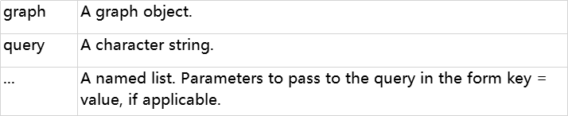
RNeo4j
cypher(graph, query, ...)
cypherToList(graph, query, ...)
graph = startGraph("http://localhost:7474/db/data/", username="neo4j", password="xiaowei")
query = " MATCH (n) RETURN distinct labels(n)"
cypher(graph,query) #get a data.frame
cypherToList(graph,query) #get a list

Slide 8
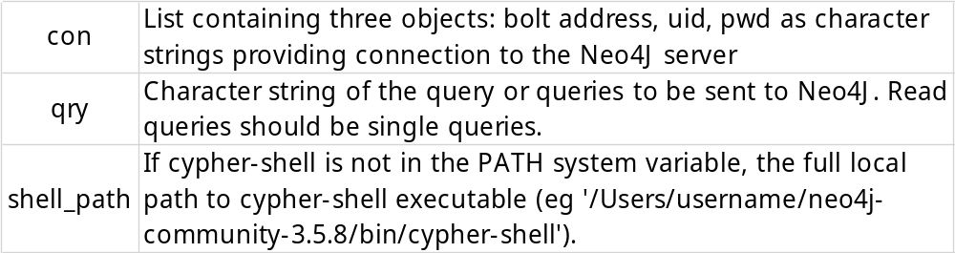
neo4jshell
neo4j_query(con = list(address = NULL, uid = NULL, pwd = NULL),qry = NULL, shell_path = "cypher-shell")
GREG <- list(address = "bolt://localhost", uid = "neo4juser", pwd = "xiaowei")
SHELL_LOC = path.expand("F:/June28/GREG/bin/cypher-shell.bat")
query <- "MATCH (n) RETURN distinct labels(n)"
neo4j_query(con = GREG, qry = query,shell_path = SHELL_LOC)

Slide 9
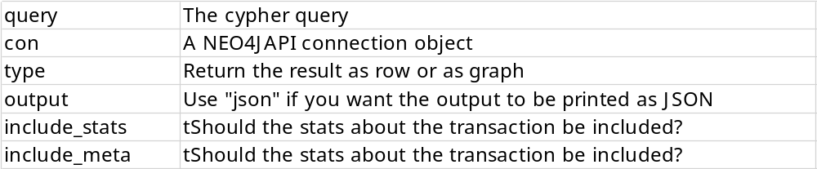
neo4r
call_neo4j(query, con, type = c("row", "graph"), output = c("r", "json"), include_stats = FALSE, include_meta = FALSE)
con <- neo4j_api$new(url = "http://localhost:7474",user = "neo4j",
password = "xiaowei")
query <- "MATCH (n) RETURN distinct labels(n)"
call_neo4j(con, query=query,type = "row")

Slide 10
Let's study!

